Slide 1


Your Logo Here
CUSTOMER GUIDE
Turning AI into Real Business Outcomes
A Practical Path from Exploration to Impact
AI is a priority for most organizations today. But many are finding it difficult to move beyond experimentation into real, measurable results. The challenge is not access to AI — it is where and how it is being applied.
The organizations seeing the most success are not starting with AI. They are starting with the right foundation —
then expanding into execution, and finally scaling with structure and strategy.

Slide 2

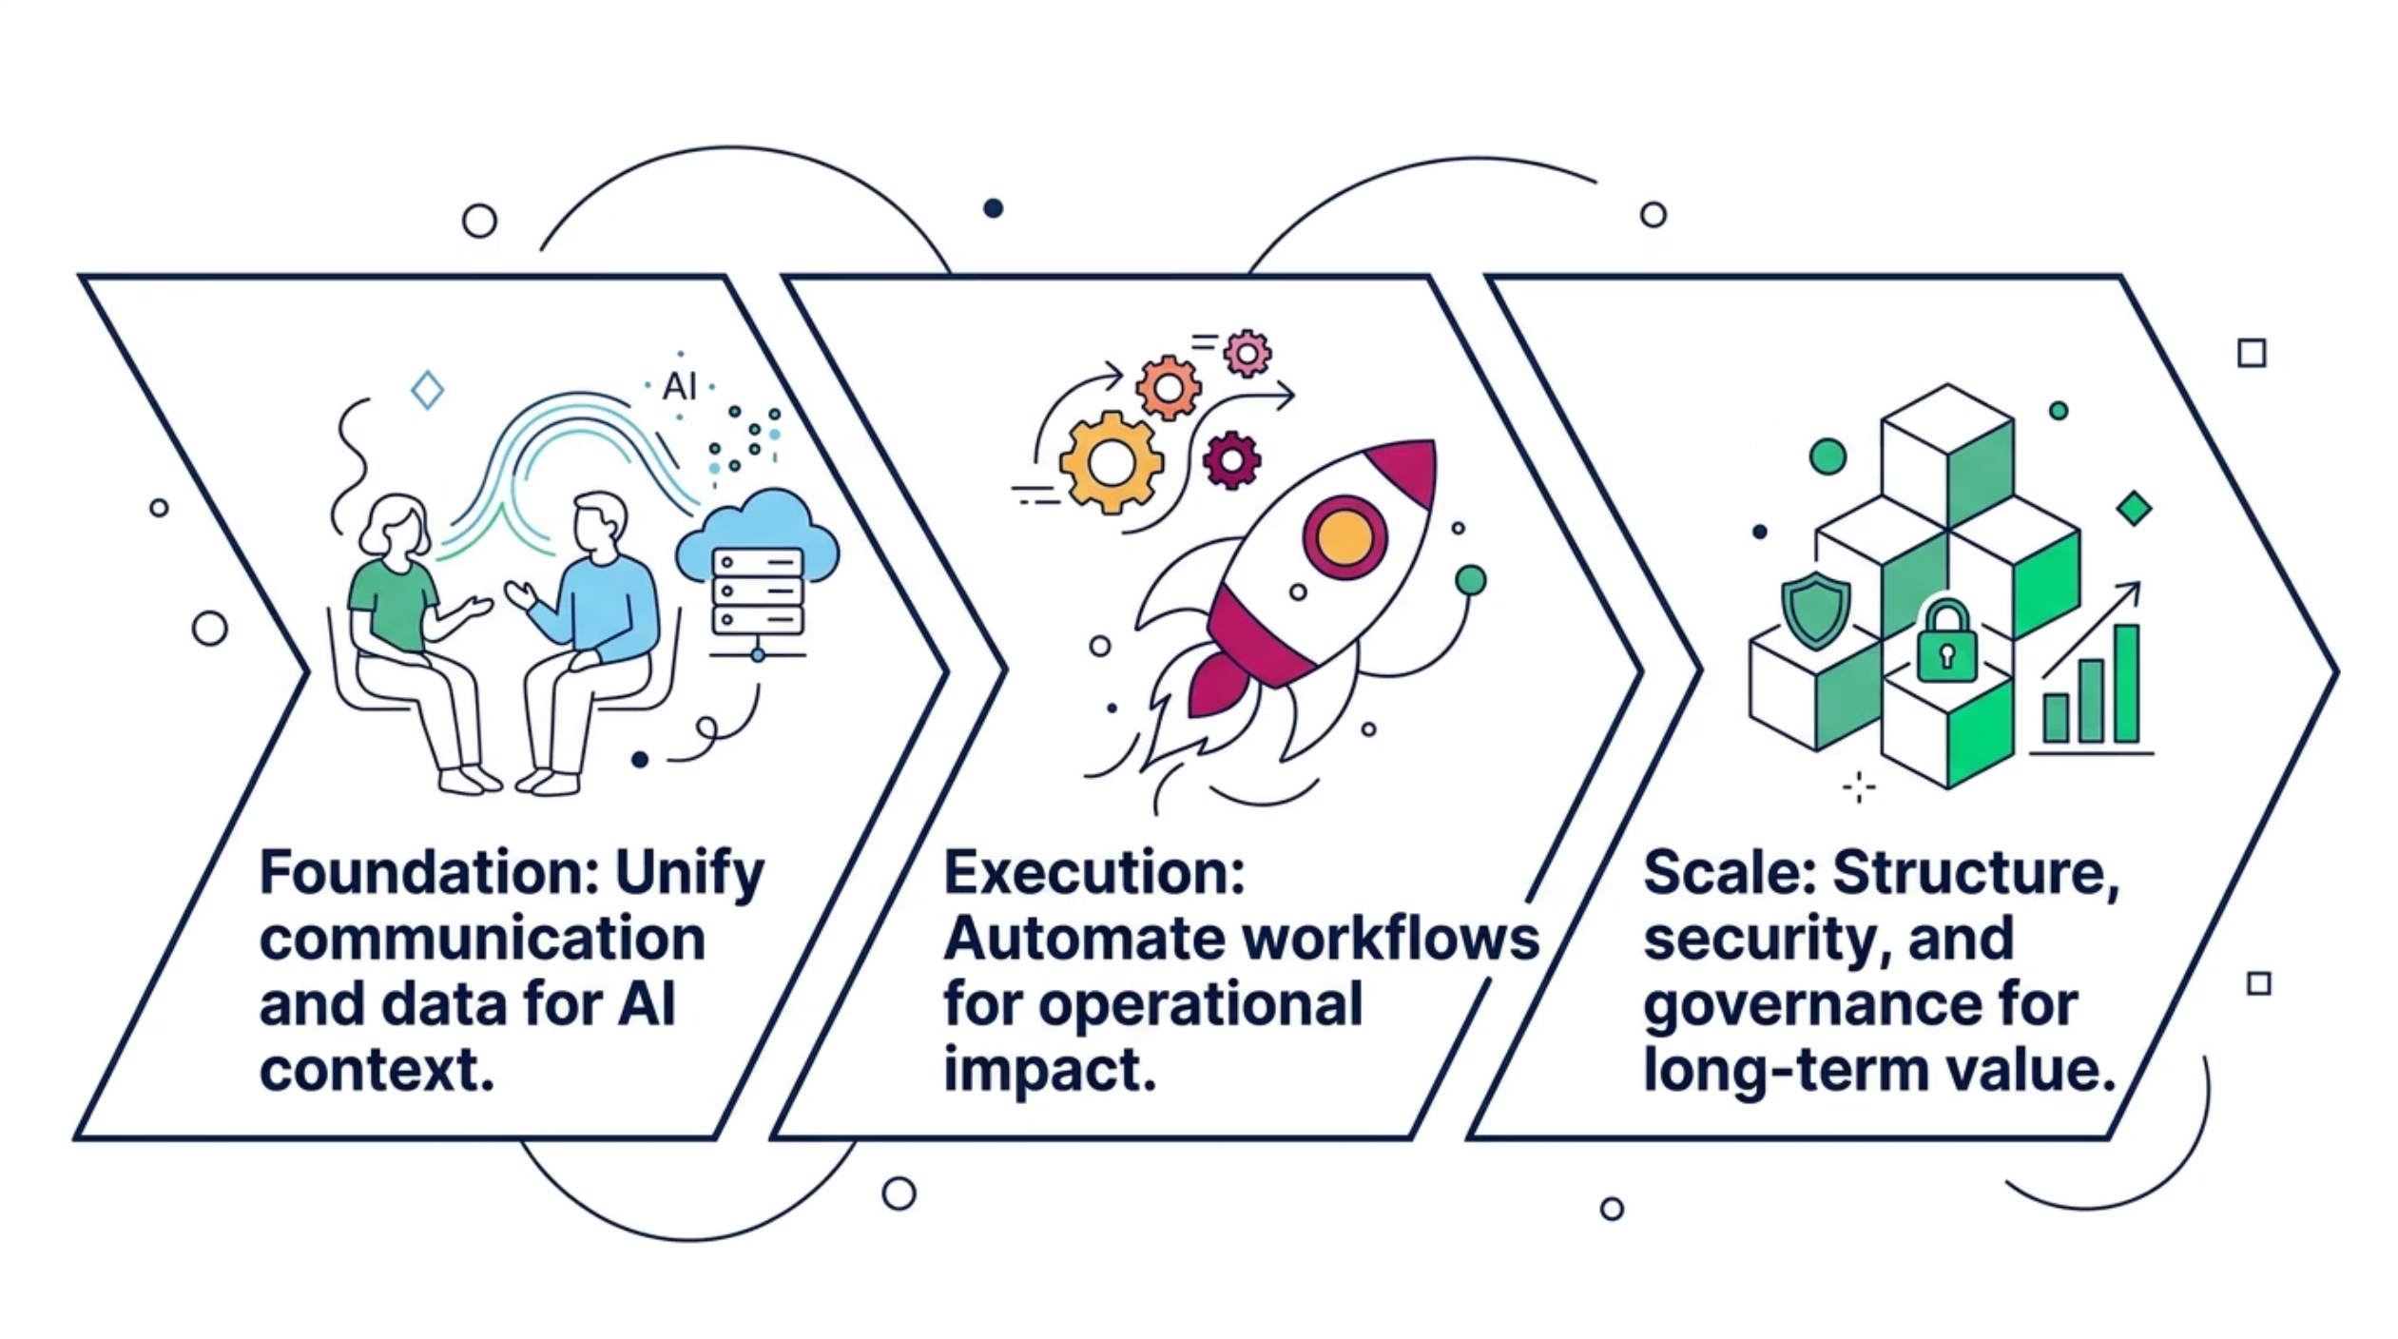

A Simple Framework for AI Success
Sustainable AI impact is built in three stages. Each stage prepares the next — and together they create a clear, repeatable path from initial exploration to measurable business value.
This is not a technology roadmap. It is a business outcomes roadmap — designed to help leaders make confident
decisions about where to invest, where to start, and how to grow.

Slide 3
Foundation: Start Where Your Data Lives
STAGE 1
Every interaction across your organization — whether with customers or employees — creates valuable data. When communication is fragmented, that data is incomplete and difficult to use. When it is unified, it creates the context AI needs to deliver meaningful results. Building the right foundation is not about technology for its own sake. It is about creating the conditions under which AI can actually work.
Why Foundation Comes First
Organizations that skip this step often find that AI tools underperform
— not because the tools are flawed, but because the underlying data is fragmented, inconsistent, or inaccessible. A unified communication and data foundation solves this before it becomes a barrier to progress.
The Key Question to Ask
Where in your business is communication siloed or data incomplete?
That gap is often the starting point for the highest-impact AI investment.
Better visibility into customer and employee interactions
More consistent experiences across every channel
Stronger, more usable data for AI to act on

Slide 4

Execution: Move from Insight into Action
STAGE 2
Once the foundation is in place, AI can begin to drive real impact by improving and automating workflows across the business. This goes beyond assisting individual team members. It enables work to be completed more efficiently, more consistently, and at greater scale — without adding headcount or increasing operational complexity.
Reduce Manual Effort
Eliminate repetitive, time-consuming tasks that drain team capacity and slow response times.
Faster Resolution
Accelerate the resolution of customer and internal requests — improving experience and efficiency simultaneously.
Operational Efficiency
Create measurable improvements in how work flows across departments, teams, and systems.

Slide 5
Scale: Bring Structure, Security, and Strategy to AI
STAGE 3
As AI adoption grows across an organization, so does complexity. Different tools, inconsistent usage patterns, and limited visibility can create risk — and slow the progress that early wins helped establish. Organizations that scale successfully introduce governance and structure around how AI is used, ensuring it remains secure, consistent, and aligned to business outcomes rather than individual experiments.
What Scaling Without Structure Looks Like
What Good Scaling Enables
Shadow AI usage across departments. Inconsistent results that erode trust. No clear line of sight from AI activity to business value. These are the risks of adoption without a scaling strategy.
Greater control and visibility across all AI usage
Improved consistency and trust in AI-generated outcomes
A clear, defensible path to long-term business value
Security and compliance built into how AI operates

Slide 6
Scale: Bring Structure, Security, and Strategy to AI
The most successful AI initiatives are not defined by the platforms or models being used. They are defined by the outcomes they deliver. When organizations lead with business objectives — rather than technology capabilities — they make better decisions, move faster, and build broader organizational confidence in AI.
Customer Experience
Cost Reduction
Improve responsiveness, personalization, and consistency across every customer touchpoint.
Reduce operational costs by eliminating inefficiencies and automating high-volume, low-complexity work.
Employee Productivity
Faster Decisions
Free up teams to focus on higher-value work by removing the friction of manual, repetitive tasks.
Enable leaders and frontline teams to make faster, more informed decisions backed by real-time data and AI-driven insight.

Slide 7
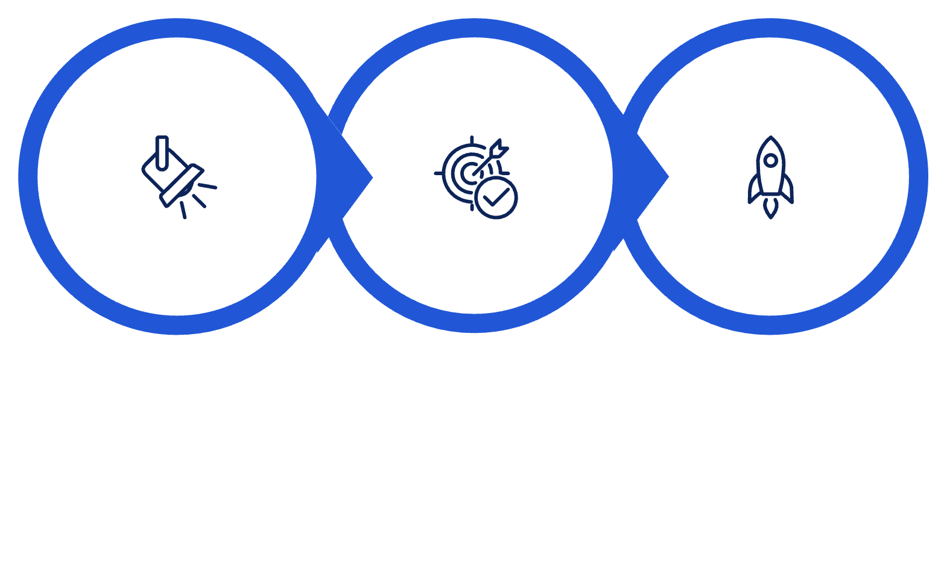
Where to Start
The organizations that see the fastest results from AI are not the ones that launch the most initiatives at once. They are the ones that identify the right starting point — and build from there with clarity and intent.
AI is not a single project. It is a journey. And the results depend on building it the right way from the very beginning.
The good news is that with the right foundation, execution, and scaling strategy, the path forward is clear — and the business outcomes are real.
Identify Friction
Define Success
Build & Expand
Ready to get started? Let's talk about where your organization is today — and what the right first step looks like
for your business.

